Slide 1

Government College of Engineering and Ceramic Technology
Seminar on proposed project :
E-DOCUMENT VALIDATION WITH AUTHENTIC SIGNATURE SHARE BASED DIGITAL SIGNATURE PROTOCOL IMPLEMENTATION APPROACH
Submitted by
KOJAGORI MAITY (GCECTB-R16-3040)
SAHELI CHAKRABORTY (GCECTB-R16-3041)
SUBRATA MAITY (GCECTB-R16-3033)
ZEBA IQBAL (GCECTB-R16-3038)
(2016-2020 CSE 4TH YEAR)
UNDER THE GUIDANCE OF
MR. SOUMIT CHOWDHURY,
(Assistant Professor of Computer Science and
Engineering)

Slide 2
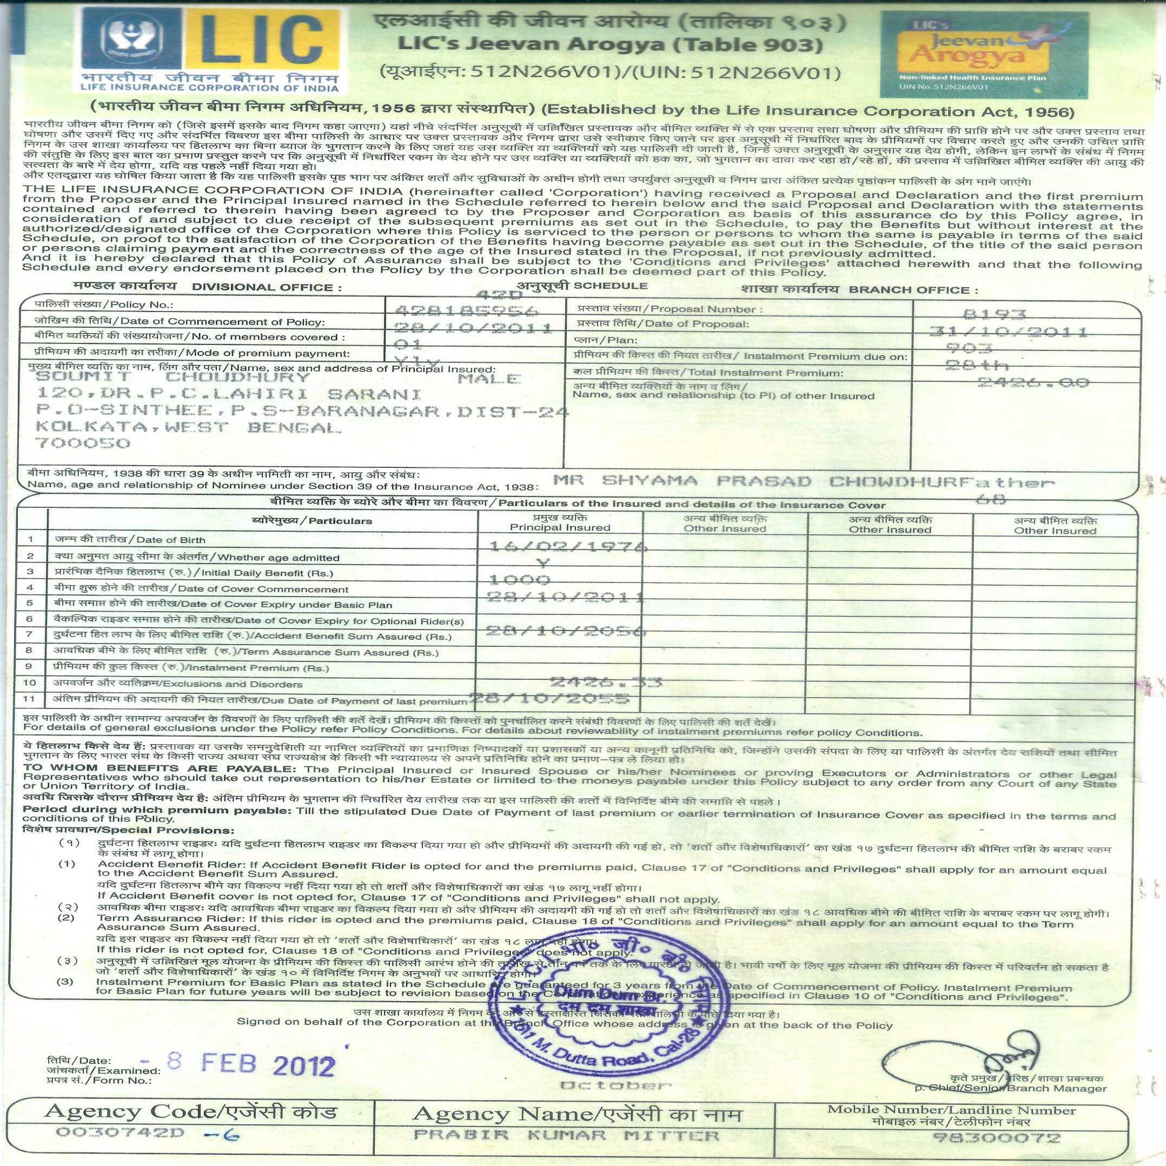
Key Issues of the Proposed Application
1. Ownership validation of both issuing authority and client perspectives.
2. Sensitive data validation with self designed hash data based signature hiding.
3. Verification of unauthorized claim by the nominee for the same e-certicate.

Slide 3
Enhancement Proposed in this Work
Dual phase validation of client authentication with secret signature sharing concepts(equivalent idea of visual cryptography) and Biometric fingerprinting.
Compliance of critical data security issues like authentication, confidentiality, data integrity and non-repudiation.
Design of secure signature share for color images aimed for robustness.
Variable encoding of secret data bits using variable threshold ranges on different pixel byte components of an image block.
Improved data hiding imperceptibility under high data payload embedding.

Slide 4
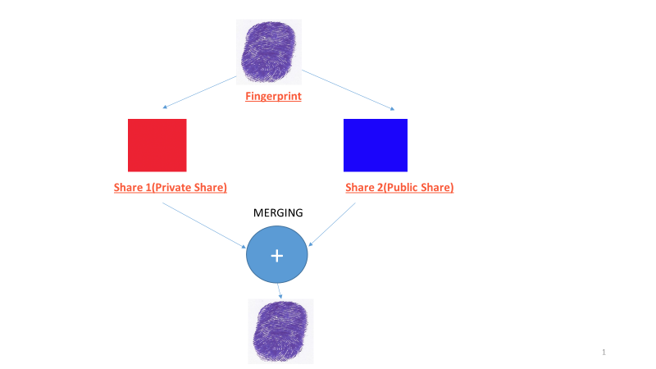

Validation of non-repudiation PROPERTY
SHARE GENERATION PROCESS

Slide 5
SHARE GENERATION AND VERIFICATION
Each pixel bytes of RGB denoted as X is represented as separate pixel byte X1 and X2
Original image pixel byte – X
First share pixel byte – X1
Second share pixel byte –X2
X1 + X2 = X [ Original reconstructed signature ]

Slide 6
SHARE GENERATION ALGORITHM
pos {1,2,3,...,N}. X_{r}=R[pos] mod 9 + (pos) mod 9 + tr
X_{g}=G[pos] mod 10 + (pos) mod 11 + tg
X_{b}=B[pos] mod 12 + (pos) mod 13 + tb…
// X_{r}, X_{g} and X_{b} denoting one set of variables for storing the intermediate encryption values for the red, green and blue intensities respectively
Y_{r}=R[pos]-X_{r}
Y_{g}=G[pos]-X_{g}
Y_{b}=B[pos]-X_{b}
// R[pos], G[pos], and B[pos] are the respective red, green and blue intensity values for the original image at pixel position ‘pos’ with tr, tg and tb denoting the threshold values used in this encryption respective to these intensities at the same pixel position ‘pos’
If(Y_{j}<0) Then S1_{j} = R[pos]; and S2_{j} = 0;
Else
S1_{j} = X_{r} ; and S2_{j} = Y_{j} ;
End If
//S1_{r}, S1_{g}, S1_{b} denoting the red, green, blue
intensity values respectively for the first share
image at pixel position ‘pos’ and S2_{r}, S2_{g}, S2_{b}
representing the red, green, blue intensity
values respectively for the second share image
at the same pixel position ‘pos’,
S1_{r}[pos]+S2_{r}[pos]=R[pos
S1_{g}[pos]+S2_{g}[pos]=G[pos
S1_{b}[pos]+S2_{b}[pos]=B[pos]
// Color intensity index j={r,g,b}

Slide 7
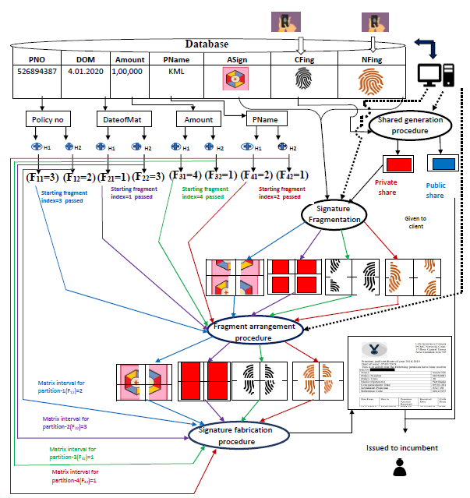
Server side signature fabrication concept

Slide 8
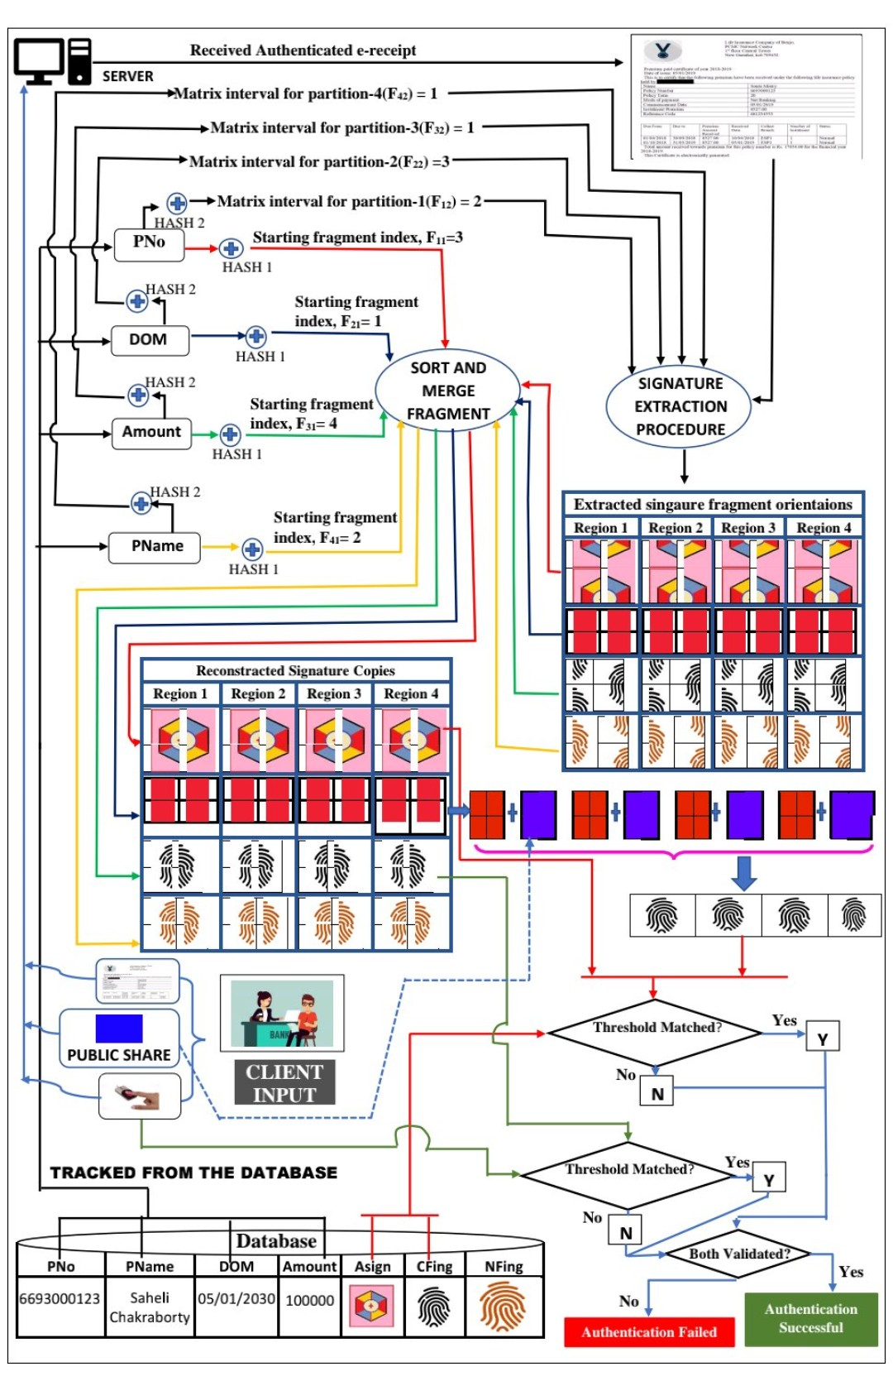
e-certificate validation for client

Slide 9
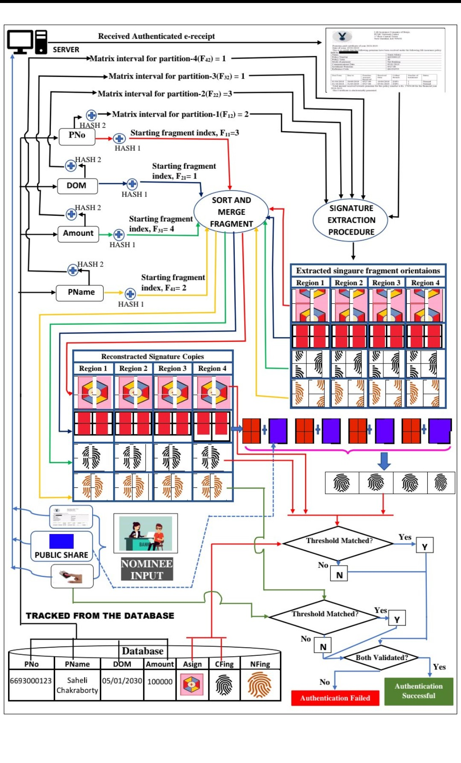
E-CERTIFICATE VALIDATION FOR NOMINEE

Slide 10
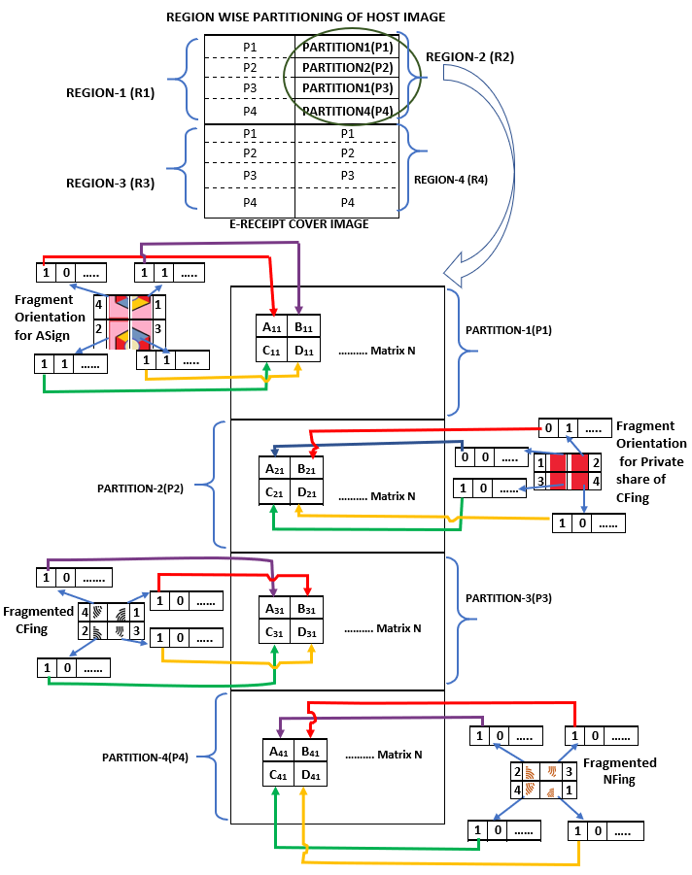
Signature fabrication concept

Slide 11

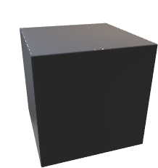

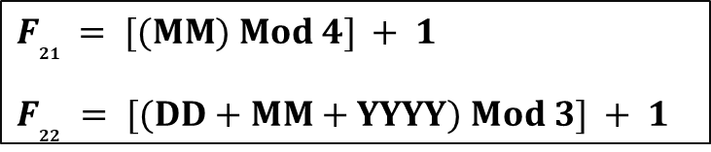
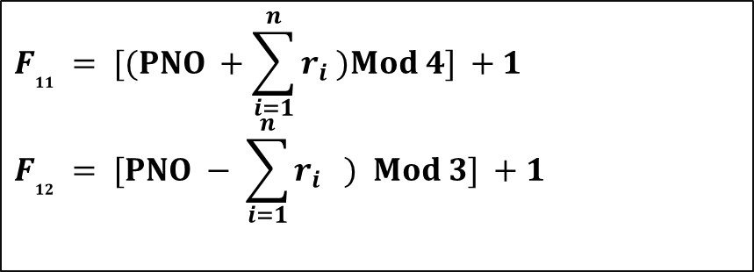
HASH 1
PARTITION 1
$$F_{11} = [(PNO +\sum_{i=1}^{n}{r_{i}} )Mod 4] +1$$
$$F_{12} = [PNO − \sum_{i=1}^{n}{r_{i}} ) Mod 3] +1$$
HASH 2
HASH 1
PARTITION 2
$F_{21 }= [(MM) Mod 4] + 1$
$$F_{22} = [(DD+MM+YYYY) Mod 3] + 1$$
HASH 2

Slide 12
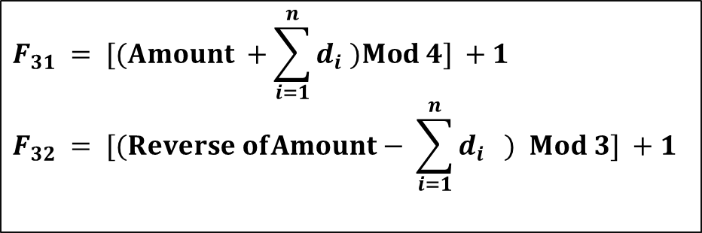

HASH 1
PARTITION 3
$$F_{31} = [(Amount +\sum_{i=1}^{n}{d_{i}} )Mod 4] +1$$
$$F_{32} = [(Reverse ofAmount− \sum_{i=1}^{n}{d_{i}} ) Mod 3] +1$$
HASH 2
HASH 1
$$F_{41} = [((\sum_{i=1}^{n}{d_{i})}+(\sum_{i=1}^{n}{p_{i}} ))Mod 4]$$
$$F_{42} =[((\sum_{i=1}^{n}{d_{i})}−(\sum_{i=1}^{n}{p_{i}} ))Mod 3]+1$$
PARTITION 4
HASH 2

Slide 13
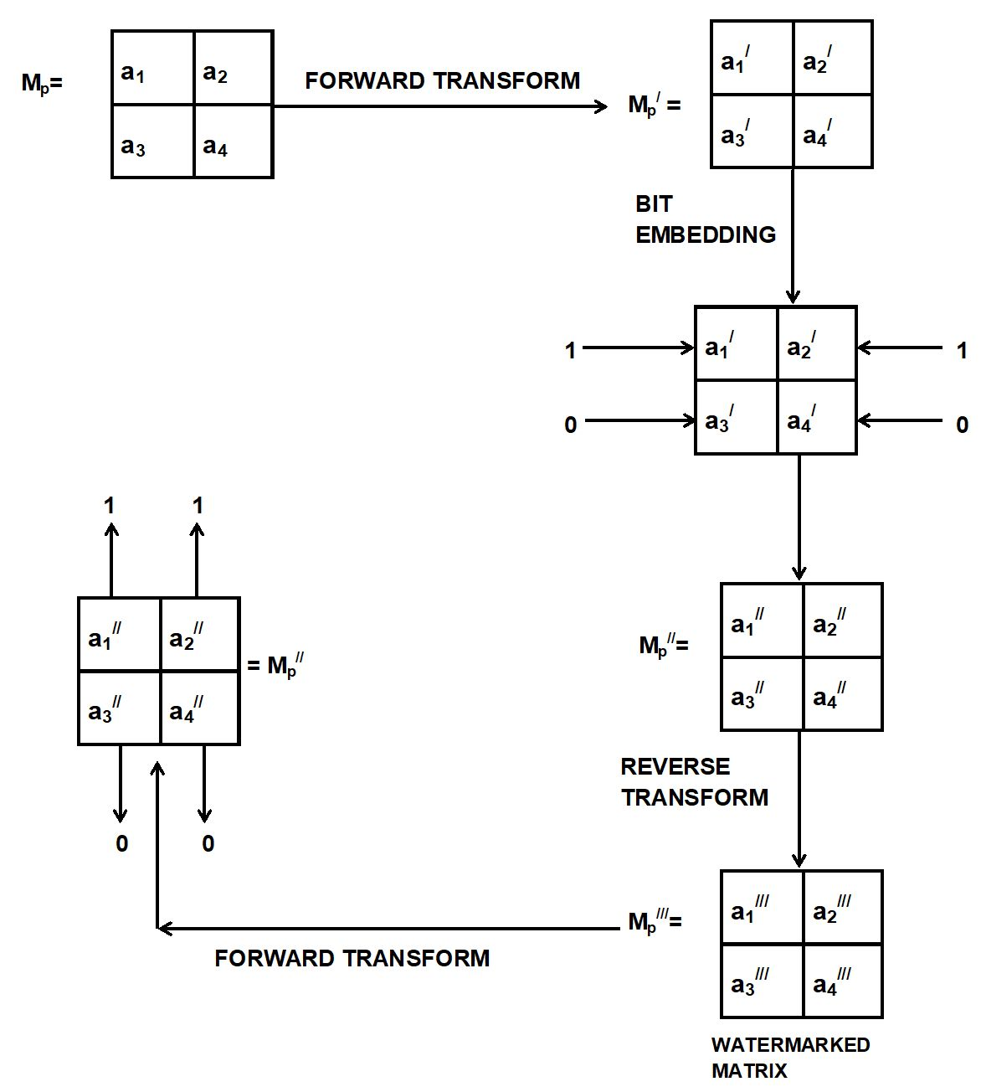

Slide 14
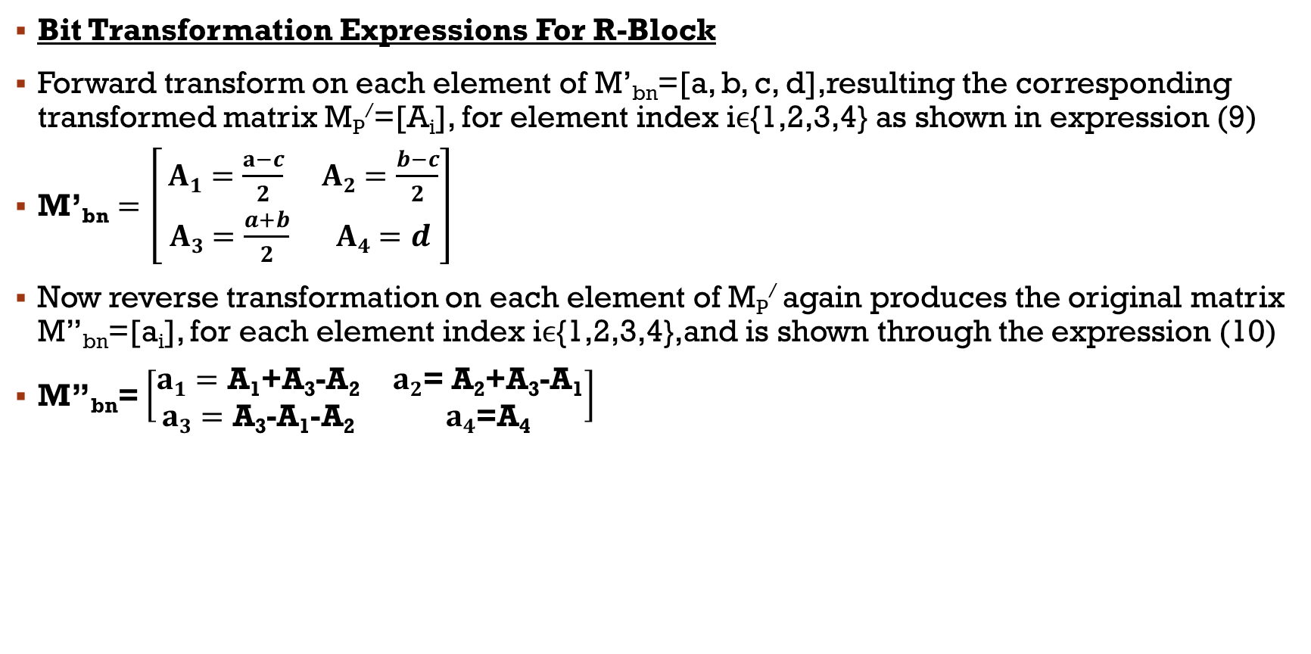
Sub-image block matrix transformation
Bit Transformation Expressions For R-Block
Forward transform on each element of M’_{bn}=[a, b, c, d],resulting the corresponding transformed matrix M_{P}/=[A_{i}], for element index iϵ{1,2,3,4} as shown in expression (9)
$\text{M}\text{’}\text{bn}=\left[\begin{matrix}A1=\frac{a−c}{2} & A2=\frac{b−c}{2} \\ A3=\frac{a+b}{2} & A4=d\end{matrix}\right]$
Now reverse transformation on each element of M_{P}/ again produces the original matrix M’’_{bn}=[a_{i}], for each element index iϵ{1,2,3,4},and is shown through the expression (10)
M’’_{bn}= $\left[\begin{matrix}a1=\text{A}\text{1}\text{+}\text{A}\text{3}\text{−}\text{A}\text{2} & a2\text{= }\text{A}\text{2}\text{+}\text{A}\text{3}\text{−}\text{A}\text{1} \\ a3=\text{A}\text{3}\text{−}\text{A}\text{1}\text{−}\text{A}\text{2} & a4\text{=}\text{A}\text{4}\end{matrix}\right]$
A₁=(a-c)/2
A₂=(b-c)/2
A₃=(a+b)/2
A₄=d

Slide 15
Threshold computation for bit encoding
M_{t}=[X₁,X₂,X₃,X₄]
Lower_{M}(d) X_{i} Upper_{M}(d)
Rf_{i} = Lower_{M}(d) + Upper_{M}(d)
2
Where, d € {4,6,8,12}
if (Ф_{i} = 1) C_{i} = Rf_{i} + 1;
else C_{i} = Rf_{i} - 1;
Index=[block no +sum of the digits of block number] mod 4

Slide 16
Bit Encoding Algorithm
Bit Decoding Algorithm
If(INDEX==0) Then
[
Rf_{i} = FUNCTION2(A_{i},{4, 6, 8,12});
i=1,2,3,4
If (C_{i} >= Rf_{i}) Then Ф_{i} =1 ;
Else Ф_{i} =0;
]
If(INDEX==0) Then
[
Rf_{i} = FUNCTION2(A_{i},{4, 6, 8,12}); i=1,2,3,4
If (Ф_{i} ==1) Then C_{i} = Rf_{i}+1;
Else C_{i} = Rf_{i}-1;
]

Slide 17
Bit Decoding Algorithm
If(INDEX==1) Then
[
Rf_{i} = FUNCTION2(A_{i},{6,8,4,12});
i=1,2,3,4
If (C_{i} >= Rf_{i}) Then Ф_{i} =1 ;
Else Ф_{i} =0;
]
Bit Encoding Algorithm
If(INDEX==1) Then
[
Rf_{i} = FUNCTION2(A_{i},{6,8,4,12}); i=1,2,3,4
If (Ф_{i} ==1) Then C_{i} = Rf_{i}+1;
Else C_{i} = Rf_{i}-1;
]

Slide 18
Bit Decoding Algorithm
Bit Encoding Algorithm
If(INDEX==2) Then
[
Rf_{i} = FUNCTION2(A_{i},{4,8,12,6});
i=1,2,3,4
If (C_{i} >= Rf_{i}) Then Ф_{i} =1 ;
Else Ф_{i} =0;
]
If(INDEX==2) Then
[
Rf_{i} = FUNCTION2(A_{i},{4,8,12,6}); i=1,2,3,4
If (Ф_{i} ==1) Then C_{i} = Rf_{i}+1;
Else C_{i} = Rf_{i}-1;
]

Slide 19
Bit Decoding Algorithm
If(INDEX==3) Then
[
Rf_{i} = FUNCTION2(A_{i},{4,12,6,8});
i=1,2,3,4
If (C_{i} >= Rf_{i}) Then Ф_{i} =1 ;
Else Ф_{i} =0;
]
Bit Encoding Algorithm
If(INDEX==3) Then
[
Rf_{i} = FUNCTION2(A_{i},{4,12,6,8}); i=1,2,3,4
If (Ф_{i} ==1) Then C_{i} = Rf_{i}+1;
Else C_{i} = Rf_{i}-1;
]

Slide 20
EXPERIMENTAL RESULTS

Slide 21
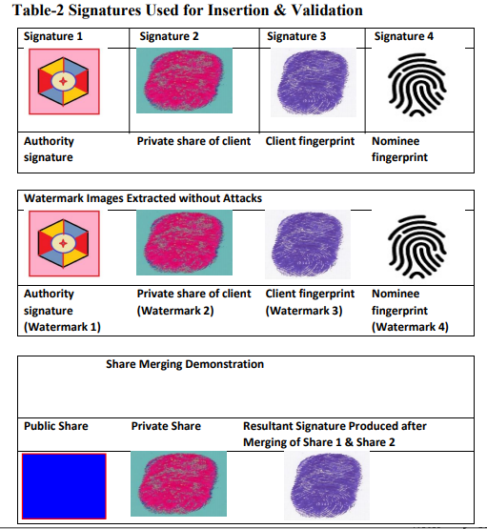
EXPERIMENTAL RESULTS

Slide 22
HISTOGRAM ANALYSIS

Slide 23
Comparison of Signature Fabrication Imperceptibility with Other Existing Approaches
Works / Approach | Signature Copies |  | Signature Image Type | Dispersing Capacity | PSNR (db)
[5,2010] Segmented |  | 03 | Grey scale | 6144 bytes | 30.11
[4,2010] Segmented |  | 16 | Binary | 4,096 bits | 39.0627 (max.)
[6,2013] Segmented |  | 09 | Grey Scale | 5,120 bytes | 33.8506 (max)
[7,2014] Segmented |  | 04 | Binary | 4,096 bits | 28.44 (max)
[15,2014] Successive |  | 02 | Grey Scale | 320 bytes | 30.79
[10,2016] Segmented |  | 02 | Color | 13,824 bytes | 38.0639 (max.)
[11,2016] Segmented |  | 08 | Binary | 8,192 bits | 38.9060
Proposed Approach |  | 16 | Color | 30,000 bytes | 38.01 (avg)

Slide 24
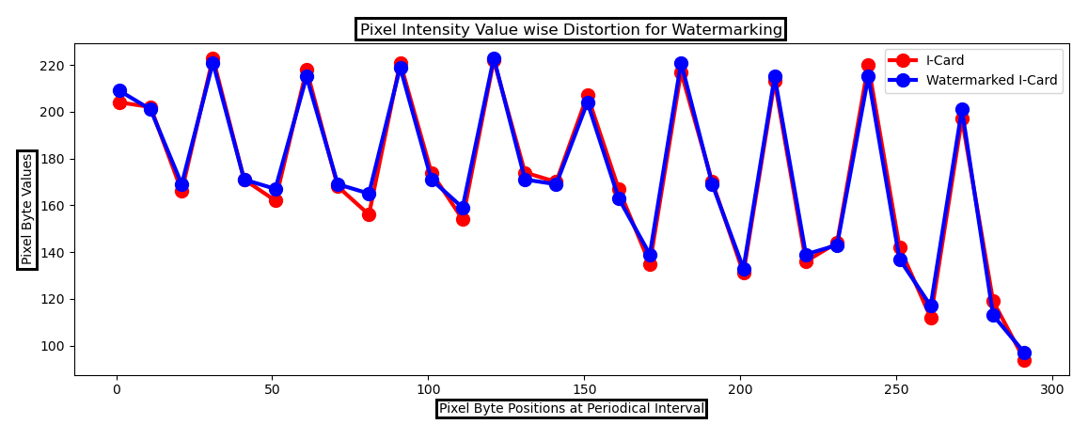
Pixel Intensity Value Wise Distortion Graph

Slide 25
FUTURE SCOPE OF WORK
The work can still be further improved in the following aspects
Resisting geometrical attacks through standardized transformation techniques.
Introduction of pattern recognition based ideas for fetching and validating the sensitive data from the e-document image and this can work as an additional layer for sensitive data validation.
Robustness analysis against various attacks and also the study of attack impact on the secret signature sharing approach in terms quality of the resultant merged signature.

Slide 26
REFERENCES
V. Anitha and R. Leela Velusamy, “Authentication of Digital Documents Using Secret Key Biometric Watermarking”, International Journal of Communication Network Security, Vol 1, Issue 4, 2012. ISSN: 2231 – 1882.
K. N. Mishra, “AAdhar based smartcard system for security management in South Asia”, In the Proceedings of International Conference on Control, Computing, Communication and Materials (ICCCCM), pp. 1-6, 2016, E. ISBN: 978-1-4673-9084-2. doi: 10.1109/ICCCCM.2016.7918256
H. R. Hasan, “Copyright Protection for Digital Certificate using Blind Watermarking Technique”, Kurdistan Journal of Applied Research, Vol 3, Issue 1, pp: 75-79, June 2018. ISSN: 2411-7706.
I. Nasir, Y. Weng, J. Jiang, S. Ipson, (2009). “Multiple spatial watermarking technique in color images”, Signal Image & Video Processing (SiViP), Vol. 4, Issue. 2, pp. 145–154. doi: 10.1007/s11760-009-0106-7.
S. Behnia, M. Teshnehlab, P. Ayubi, “Multiple watermarking scheme based on improved chaotic maps”, Communication in Nonlinear Science and Numerical Simulation, Vol. 15, Issue. 9, pp. 2469-78. 2010, doi:10.1016/j.cnsns.2009.09.042
G. Bhatnagar, Q. M. J. Wu, “A new robust and efficient multiple watermarking scheme”, Multimedia Tools & Application, Vol. 74, Issue. 19, pp. 8421-8444, 2013, doi:10.1007/s11042-013-1681-8.
M. Babaei, K. Ng, H. Babei, H. G. Niknajeh, “Robust multi watermarking scheme for multiple digital input images in DWT domain” International Journal of Computer and Information Technology, Vol. 3, Issue. 4, pp. 834-840, 2014
M. Natarajan, Y. Govindarajan, “Performance comparison of single and multiple watermarking techniques”, International Journal of Computer Network and Information Security, vol. 6, Issue. 7, pp 28-34, 2014. DOI: 10.5815/ijcnis.2014.07.04

Slide 27
REFERENCES
9. N. Mohananthini, G. Yamuna, “Image fusion process for multiple watermarking schemes against attacks”, Journal of Network Communications and Emerging Technologies, vol. 1, Issue. 2, pp. 1–8, 2015. ISSN: 2395-5317.
10. N. Mohananthini, G. Yamuna, “Comparison of multiple watermarking techniques using genetic algorithms”, Journal of Electrical Systems & Information Technology, vol. 3, issue 1, pp.68–80, 2016, DOI: https://doi.org/10.1016/j.jesit.2015.11.009
11. R. Sadh, N. Mishra, S. Sharma, “Dual plane multiple spatial watermarking with self encryption”, Sadhana, Indian Academy of Sciences, Vol. 4, Issue. 1, pp. 1-14, 2016
12. Radharani, S., Valamathi, M.L. (2011), “Multiple Watermarking Scheme for Image Authentication and Copyright Protection Using Wavelet Based Texture Properties and Visual Cryptography” Int. Journal of Computer Applications (IJCA), 23(3), 29-36.
13. Thanki, R.M., & Borisagar, K.R. (2013), “Combined DCT–CS Theory Based Digital Watermarking Technique for Color Images” In Proc. of National Conf. on Emerging Trends in Information & Communication Technology (NCETICT 2013), Chennai, Tamil Nadu: Published by Int. Journal of Computer Applications (IJCA), 17-23.
14. A.K. Singh, B. Kumar, M. Dave, A. Mohan, “Multiple watermarking on medical images using selective DWT coefficients”, Journal of Medical Imaging and Health Informatics, vol. 5, Issue. 3, pp. 607-614, 2015.
15. Thanki, R. M., & Borisagar, K. R. (2014) “Compressive Sensing Based Multiple Watermarking Technique for Biometric Template Protection”, International Journal of Image Graphics and Signal Processing, Vol. 7, Issue 1, pp 53–60.

Slide 28
Thank You

